Slide 1


-By Payal Ghosalkar, Deepika Sherawat, Deekshith, Neha Sharma,
Raksha Kale.
Project No : P272
Fake News Classification
Countering the spread of fake news is critical for ensuring trust in media and democracy. In this presentation, we explore an approach to classifying fake news.

Slide 2



What is Fake News?
Intentional Misinformation
Misleading Content
False information spread deliberately to deceive people.
News stories with sensational or misleading headlines that fail to provide accurate context.
Propaganda
Deliberate dissemination of information geared towards supporting a particular ideology or viewpoint.

Slide 3

Business Problem & Objectives
1
The problem
With the abundance of news sources available today, it's becoming increasingly difficult to separate real news from fake. We aim to solve this problem.
2
Objectives
Develop a system to detect and classify fake news using machine learning. Evaluate the accuracy of our model and improve it where possible.

Slide 4
Project Architecture & Flow
Business Problem
Data Analysis
Data Preprocessing
Feature Extraction
Model Building
Model Predictions
Model Evaluation
Model Deployment

Slide 5
Libraries
Dataset Details & Libraries Required
Libraries
We use Python libraries such as Seaborn, Matplotlib, Pandas, Numpy, Scikit-learn, nltk and collections to preprocess the dataset and train the Model .
.
1
2
3
Source
Features
We are going to use a dataset comprises of roughly 44898 articles. The dataset is divided into two separate datasets, one containing real news and the other containing fake news.
Both the datasets includes features such as “Title” , “Text”, ”Subject”, “Date” and one added feature “Class” which identifies whether News are fake or real. Number 0 for fake news and 1 for real news.

Slide 6
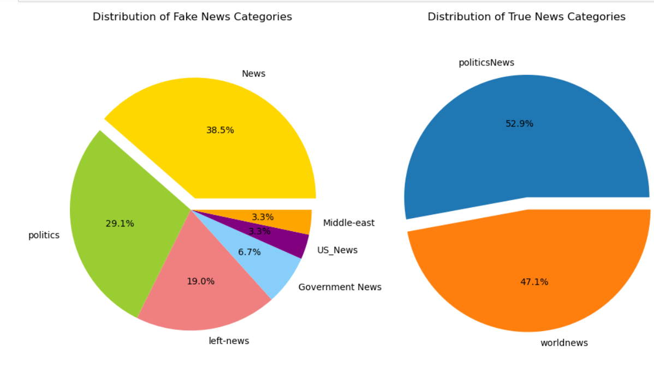
Fake news data is categorized into 6 subjects, including Politics, Middle-East, US News, Government News, and Left News.
Real news data is divided into 2 subjects, specifically Politics News and World News.
Exploratory Data Analysis & Visualization
Distribution of the News By Their Subjects :

Slide 7
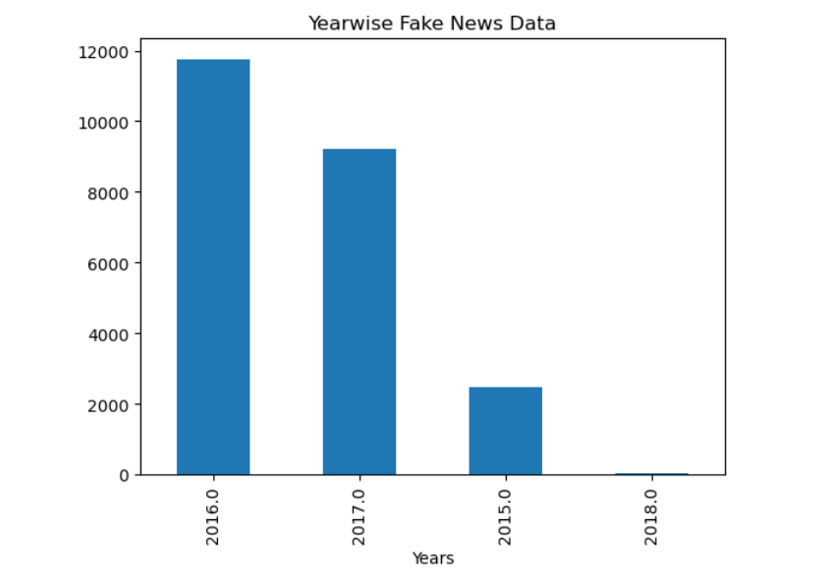
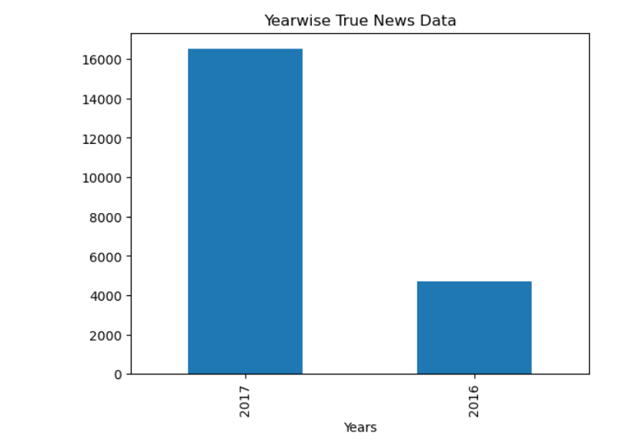
Year Wise News Distribution
Fake News span across the years 2015, 2016, 2017, and 2018.
Real News are exclusively from the years 2016 and 2017.

Slide 8
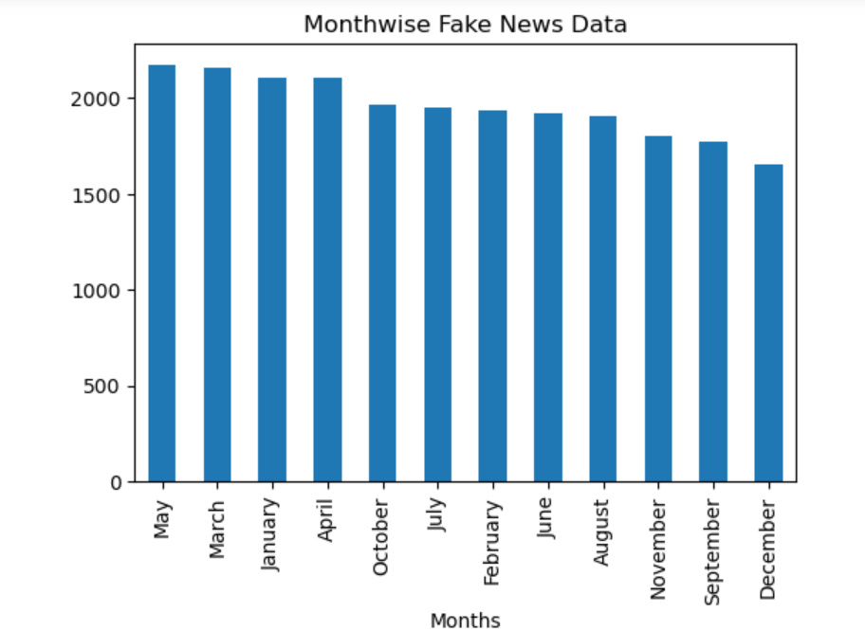
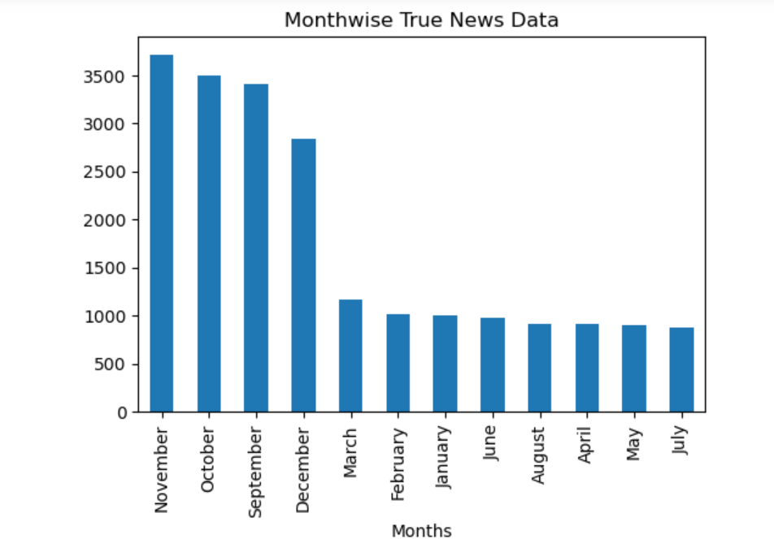
Fake news data, exhibits consistent news generation throughout the months from January to December. Indicates a higher frequency of fake news production compared to real news.
True news data, show a news generation primarily in the months of November, October, September, and December .Suggests that true news production is more prominent during specific months.
Months Wise News Distribution

Slide 9
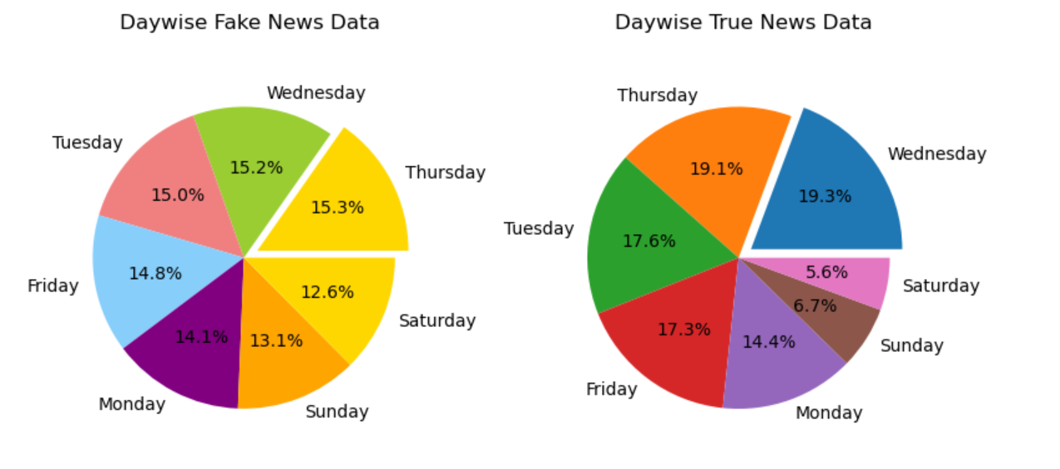
In fake news dataset, Consistent news generation count observed across all days.
In real news dataset, News generation count notably lower on weekends, indicating reduced activity compared to weekdays.
Days wise News Distribution :

Slide 10
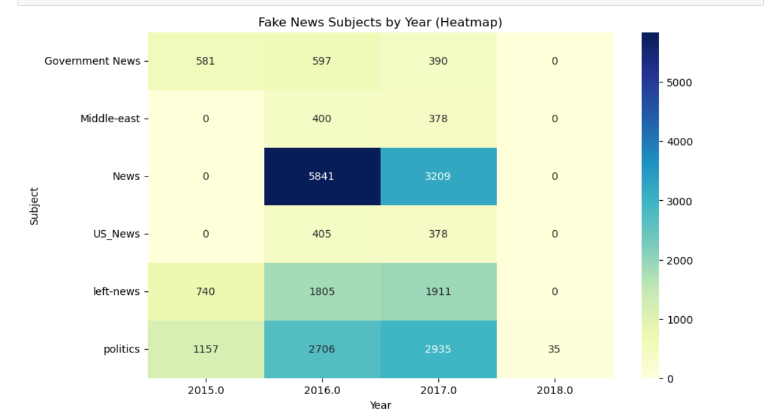
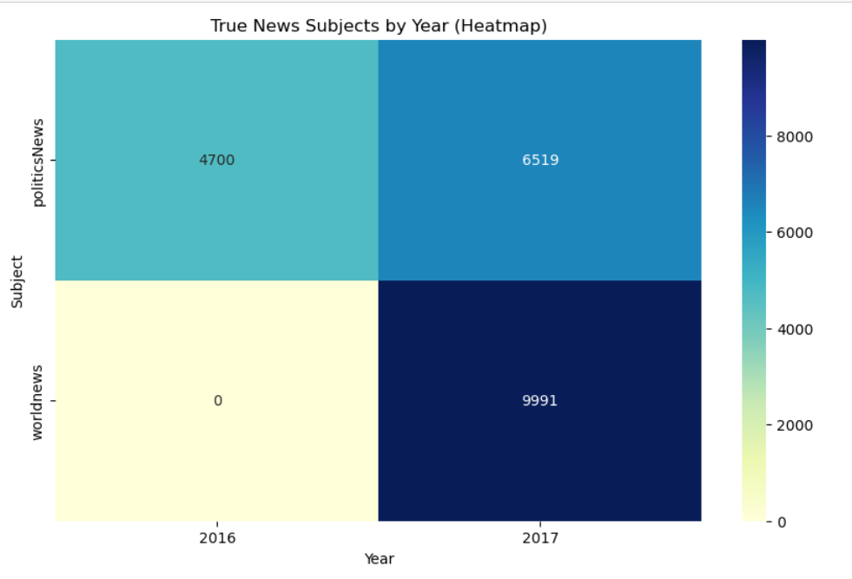
Fake news data exhibits varied subjects with a prominent concentration in the "news" category in 2016.
Real news data is focused on two subjects, with a significant number of news articles under "World news" in 2017,
whereas there are no "World news" articles recorded in 2016.
Year & Subject Wise News Distribution

Slide 11
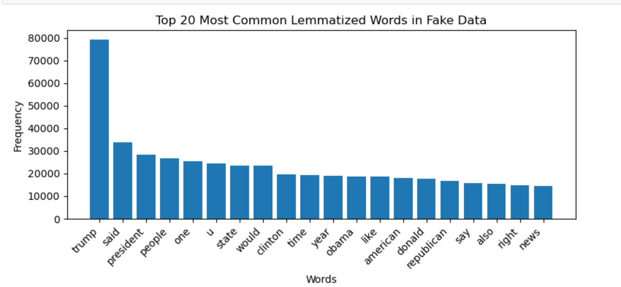
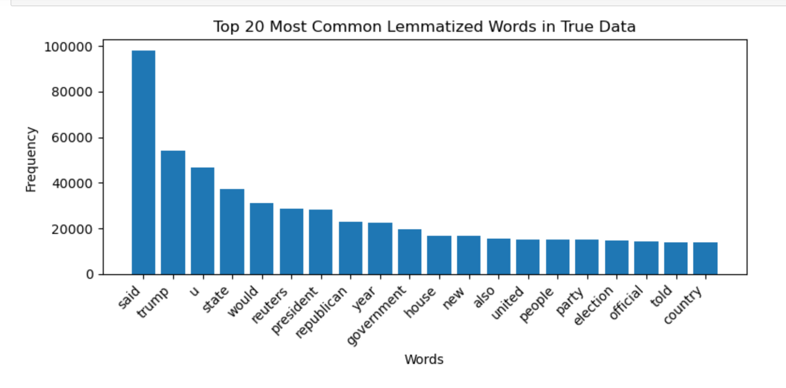
"Trump“, "president“, "people" and "Republican" are among the most frequent words in fake news.
"Said" ,"Trump“, "Reuters" and "government" emerge as the prominent common words in true news.
Overlapping terms such as "Trump" and "year" are present in both datasets.
Unigrams

Slide 12
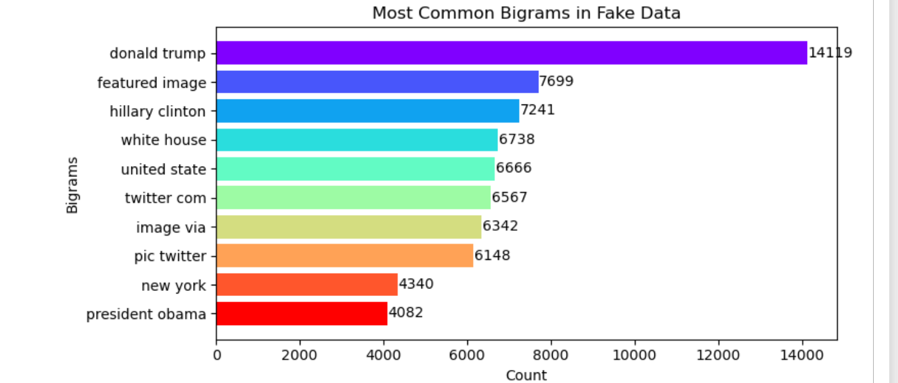
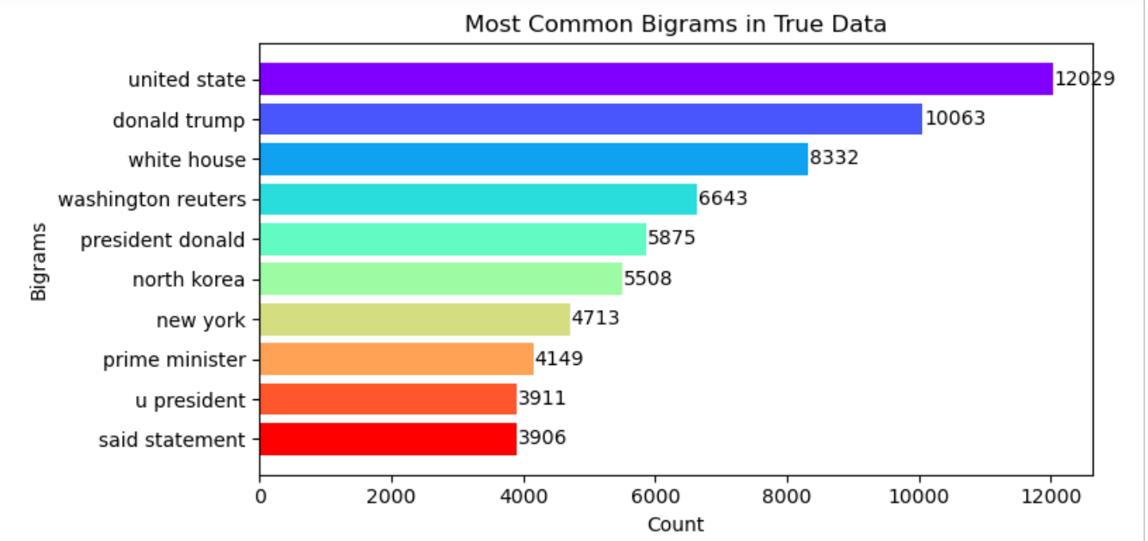
"Donald Trump“ with high count of 14119 & “president Obama” with low count of 4082 are bigrams in fake news.
“United state“ with high count of 12029 & “said statement” with low count of 3906 are bigrams in real news.
Shared bigrams such as "Donald Trump" and "White House" are also present in both the datasets.
Bigrams

Slide 13
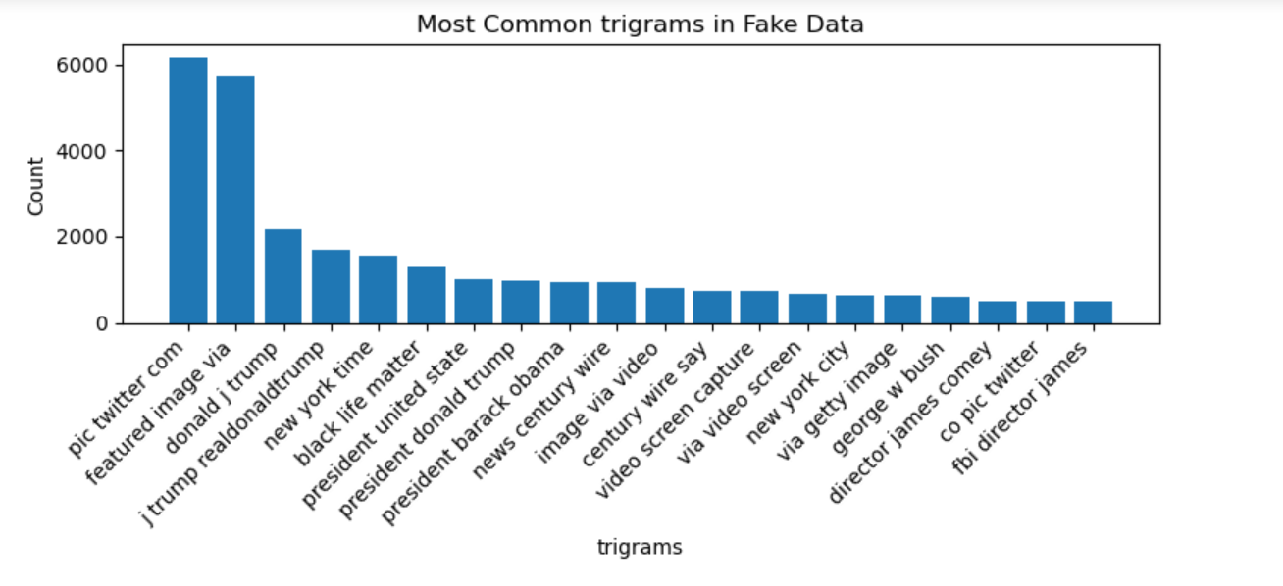
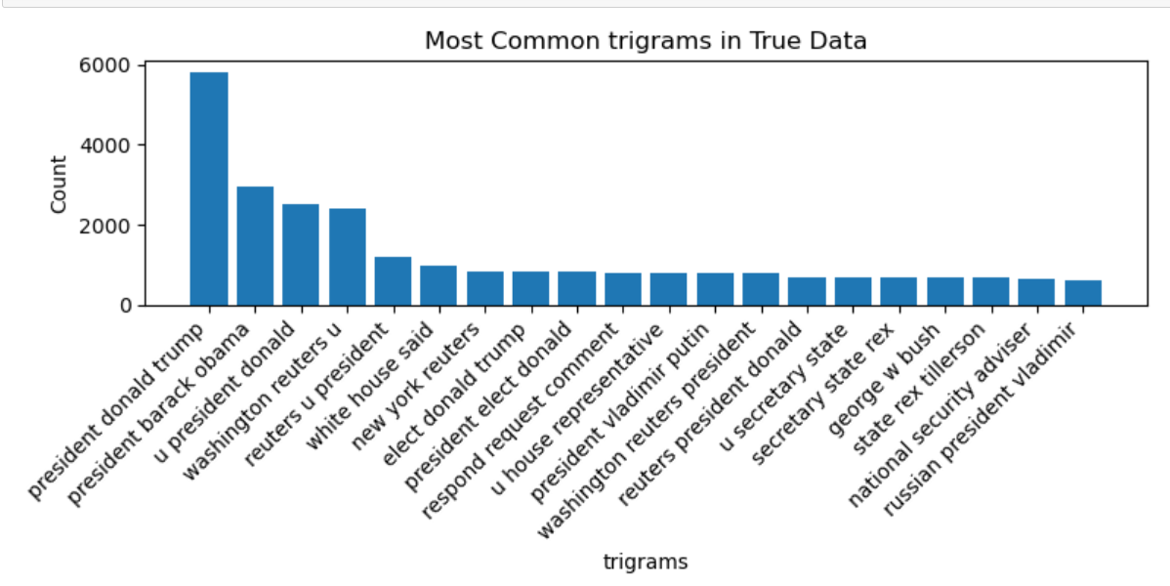
“Pic Twitter Com" with the high count & “fbi director james” with the low count words in fake news.
“President Donald trump" with the high count & “Russian president Vladimir ” with the low count words in fake news.
Shared trigram such as “George W Bush" are also present in both the datasets.
Trigrams

Slide 14
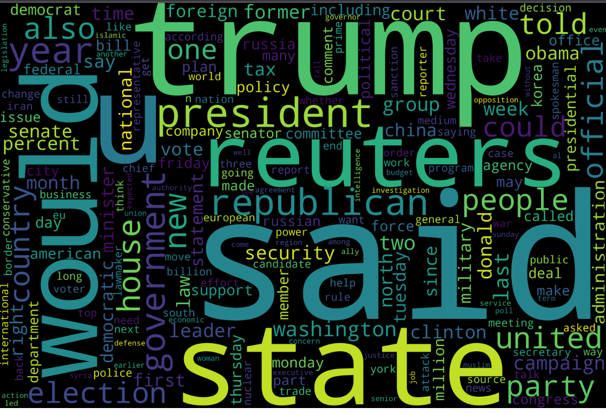
Wordcloud of True News Dataset

Slide 15
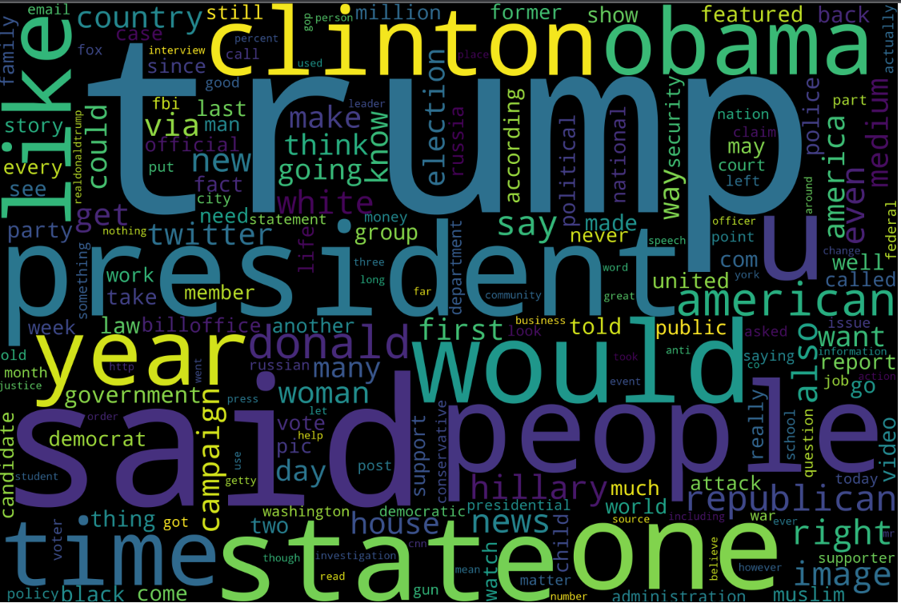
Wordcloud of Fake News Dataset

Slide 16
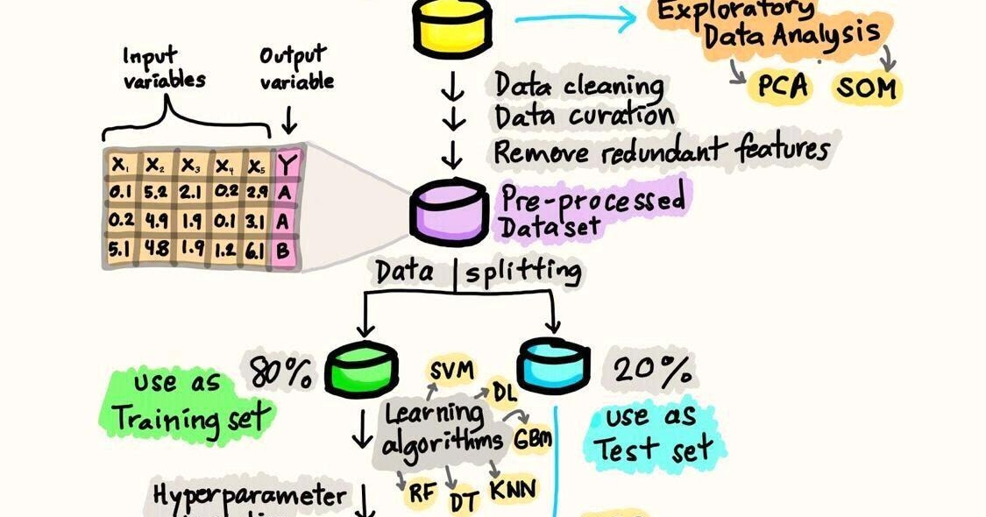
In our project we have built the model using below algorithms :
1. Random Forest
2. Logistic Regression
3. Decision Tree
4. SVM
5. Gradient Boosting
6. Ridge Classifier
7. Naive Bayes
Model Building

Slide 17
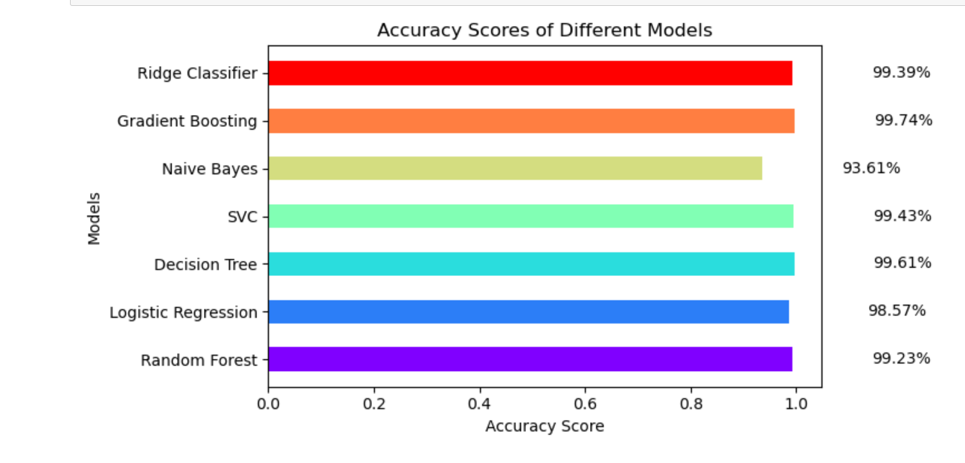
We have got the final model “Gradient Boosting “ from the below plot with highest accuracy score of 99.74 %.
Model Evaluation

Slide 18
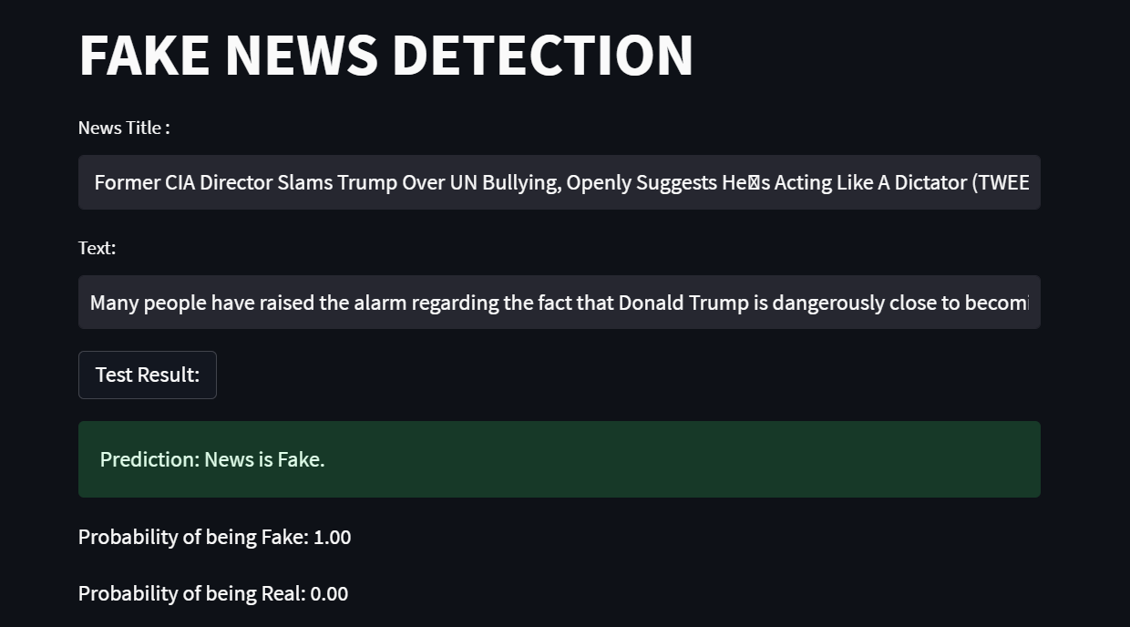
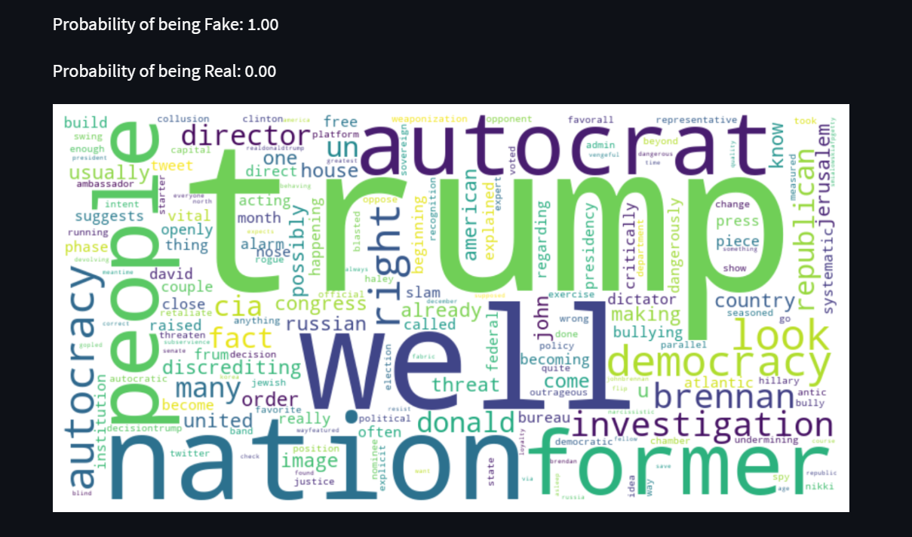
Below are the interface for the model deployment where word cloud showing words which is responsible for the result.
Model Deployment

Slide 19
Challenges Faced & Strategies to Overcome Challenges
Obtaining reliable labeled data for training is difficult.
Handling disproportionate genuine and fake news samples.
Adapting to changing misinformation techniques, such as deepfakes.
Creating models effective across diverse news topics.
Capturing nuanced meanings within content.
Analyzing news promptly in fast-paced environments.
Building models resistant to manipulative inputs.
Balancing misinformation filtering with free speech.
Ensuring adaptability to new forms of fake news.
Understanding decision rationale in complex models.
Defining metrics that mirror real-world consequences.
Enhance dataset quality through augmentation and meticulous labelling.
Keep the model updated to combat evolving misinformation tactics.
Develop efficient real-time processing pipelines for timely news analysis.
Train models against adversarial samples to enhance resistance.
Extract transferable features for adaptability to new fake news forms.
Focus on interpretable models for understanding classification decisions.
Define comprehensive metrics reflecting societal impact and user trust.

Slide 20
Conclusion
Classification of fake news is critical for preserving trust and integrity in media and democracy.
Our proposed approach achieves high accuracy and performance on different datasets.
Future work can focus on improving feature selection and augmenting data for better model performance.

